Slide 1
LISA Consultation
10/30/24

Slide 2
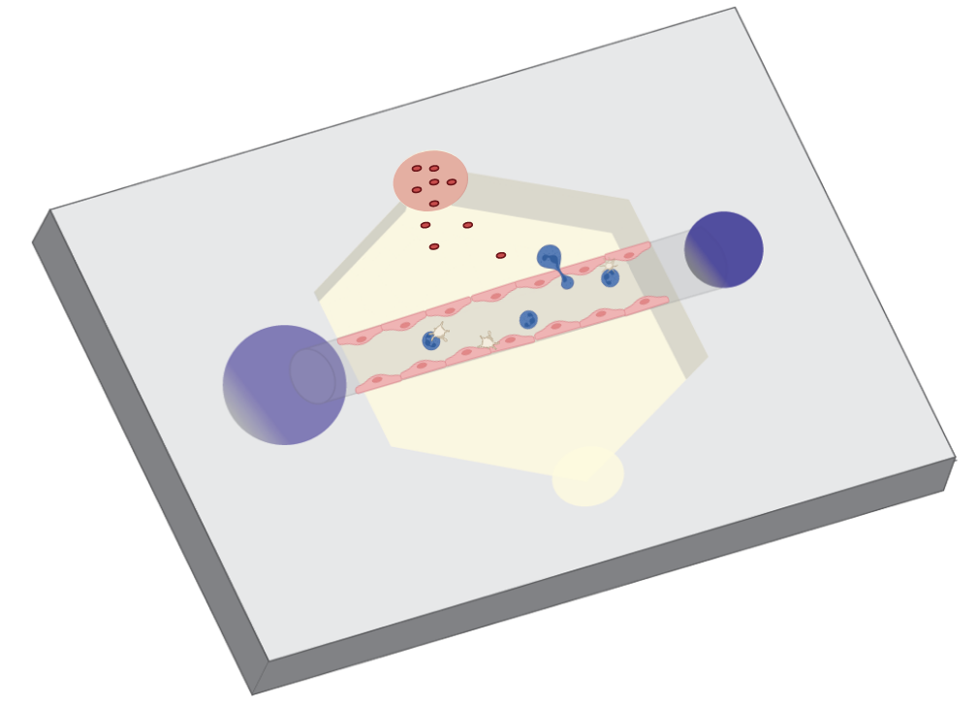
Our Work
Goal to understand dynamics of innate immune system
Use model blood vessel to watch immune cell activity

Slide 3
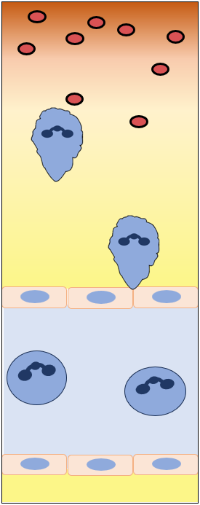
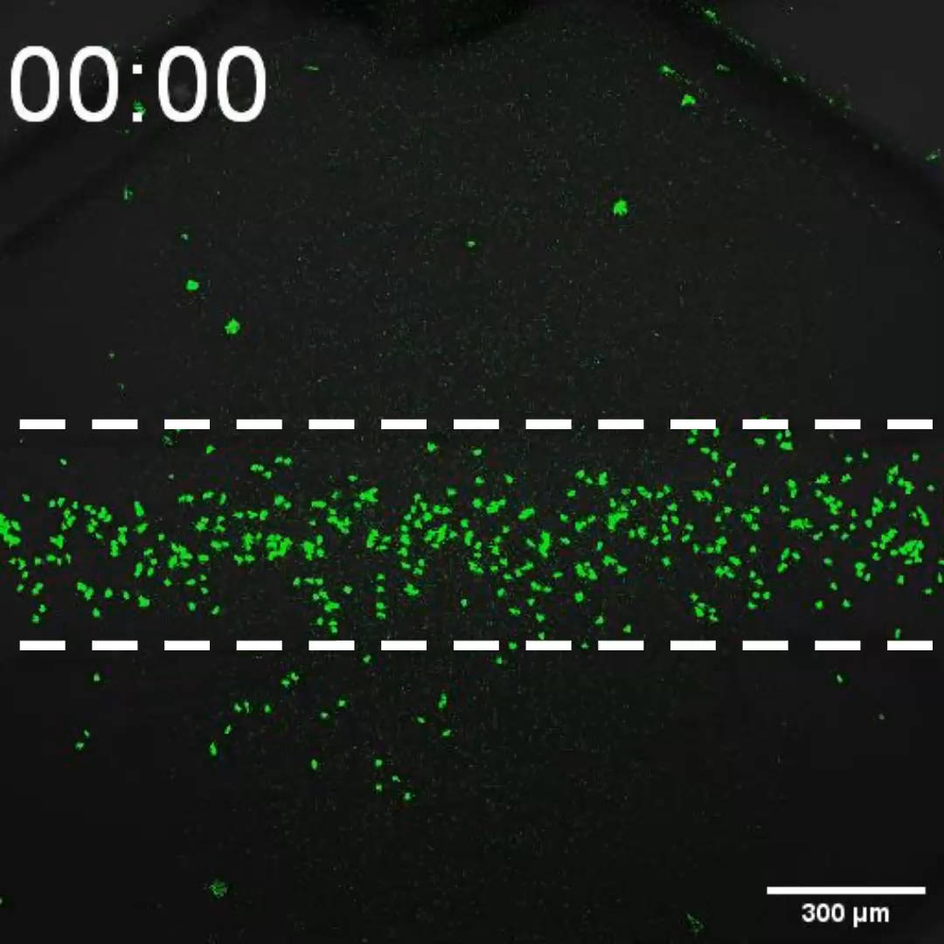
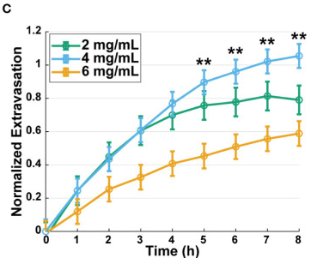
Our Experiment

Slide 4
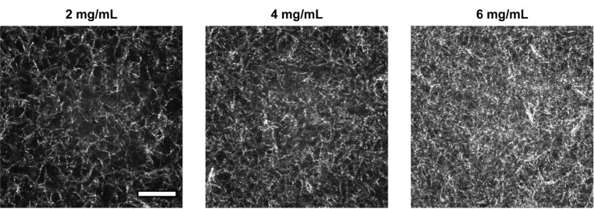
Our Experiment:
Vary collagen concentration
Observe neutrophil extravasation differences

Slide 5
Our Variables:
Collagen Concentration
Time Dependence
Experimental Replicate

Slide 6
Our Current Statistical Analysis
Emmeans – Estimated marginal means of linear regression based on “factors”

Slide 7
Our Questions for You
What is emmeans doing to analyze our data?
How are error bars determined?
Is emmeans the right tool for this analysis?
Do we have the right regression model?
How could we make it better?
What assumptions go into a regression model, and how do we confirm we meet those requirements?

